Slide 1

An Explainable Cost-Sensitive
Credit Risk Assessment Model
Bhawna Gupta
Student ID : 980432

Slide 2
Introduction
Credit Risk Assessment
Credit risk is probability of default of loan that a lending firm may not receive the owed principal and interest amount from the borrower.
Impact of Loan default
Loss in profitability
Interruption in cash flows
Increase in collection cost
Credit risk assessment model will predict the default risk associated with the new loan application before granting the loan.

Slide 3
Introduction
Credit assessment model should be accurate and interpretable.
Feature of the credit assessment model
Cost-sensitive
Explainable
Benefits
Cost Sensitive
Explainability
Low misclassification cost
Better model performance
Transparent credit assessment
Gain the customer trust in the model

Slide 4


Objectives
Imbalanced Dataset
Challenges with machine learning model
Research Questions:
Will oversampling technique improve the performance of the model in case of data imbalance?
Will the result of the black-box model be interpretable?
Black-box Nature
Objectives
To analyze performance of ensemble classifiers.
To find an optimal resampling technique
Evaluate model’s performance using misclassification cost metrics
To suggest an explainable AI method

Slide 5
Literature Review
37 studies were reviewed from 2018-2021 on credit assessment model.
Out of 37, twenty five studies implement their cost-sensitive model using boosting classifiers.
8 studies were implemented using cost-sensitive neural network. But some of them were facing the overfitting issue.
Ensemble of Neural network with boosting classifiers were performed better.

Slide 6
Literature Review
To handle imbalance problem 14 studies used resampling techniques.
Only six studies were based on explainable AI to interpret the result.
And combination of both is none.

Slide 7
Methodology
Dataset Description
A eleven year of data (2007-2018) of the Lending club dataset was being used.
Loan_status feature was the target feature.
Dataset was divided into individual and joint applicant type.
Data Cleaning
Columns that had more than 50% null values were removed.
Remaining null values were imputed with mean and mode values.
Outliers were capped with suitable percentile values to reduce the data variance.
Columns with more than 80% skewness were removed.
Redundant features were removed from the dataset.

Slide 8
Methodology
Model Preprocessing
Transforming categorical features to numerical feature using label encoding.
Split of dependent and independent features.
Normalization of data using standard scaler.
Split of train and test set.
Model Implementation
Three boosting classifiers XGBoost, LightGBM and CatBoost were trained on dataset.
Stacking model of all three boosting classifiers was trained on train data.
Hyperparameter tuning was done using RandomizedSearchCV.

Slide 9
Methodology
Resampling Technique
Performance of two oversampling technique SMOTE and ADASYN were compared.
Cost-sensitive Evaluation Metrics
AUC-score, F1-score, G-mean, precision and recall were used to evaluate the performance.
Type-I error and type –II error metrics was used to calculate the misclassification cost.
Model Explainability
SHAP explainable AI was used to calculate the features contribution in the prediction result.

Slide 10
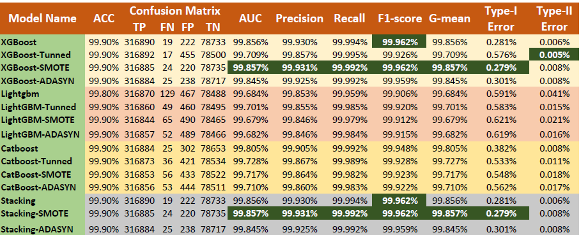
Result & Discussion
Cost-sensitive metrics result for the individual test set
XGBoost and Stacking Classifier with SMOTE achieved the lowest misclassification cost (Type-I and Type-II error).

Slide 11
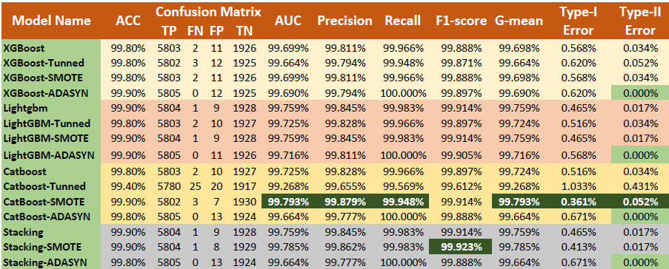
Result & Discussion
Cost-sensitive metrics result for the Joint test set
For low volume dataset only CatBoost with SMOTE has lowest misclassification cost.

Slide 12
Result & Discussion
Comparative performance analysis with previous studies
Paper | Model | AUC | F1-Score | G-mean | Sensitivity | Specificity
Best performing model in the previous study
(Yotsawat et al., 2021a) | CS-NNE | 70.82 | - | 65.00 | 62.69 | 67.41
 | XGBoost | 69.69 | - | 30.87 | 9.79 | 98.21
(He et al., 2018) | EBCA | 73.06 | 99.38 | 1.638 | - | -
 | XGBoost | 71.45 | 99.35 | 0.00 | - | -
(Chengeta and Mabika, 2021a) | CNN | 99.74 | 95.39 | - | 92.30 | -
 | XGB | 99.44 | 86.23 | - | 94.30 | -
 | LightGBM | 99.76 | 89.54 | - | 97.04 | -
 | CatBoost | 99.55 | 87.19 | - | 99.00 | -
(Kun et al., 2020a) | Stacking | 98.11 | 98.32 | - | 98.68 | -
 | XGBoost | 97.69 | 97.95 | - | 98.40 | -
Best performing model in this study
Individual Dataset | XGBoost-SMOTE | 99.86 | 99.96 | 99.86 | 99.92 | 99.72
 | Stacking-SMOTE | 99.86 | 99.96 | 99.86 | 99.92 | 99.72
Joint Dataset | CatBoost-SMOTE | 99.79 | 99.91 | 99.79 | 99.95 | 99.64

Slide 13
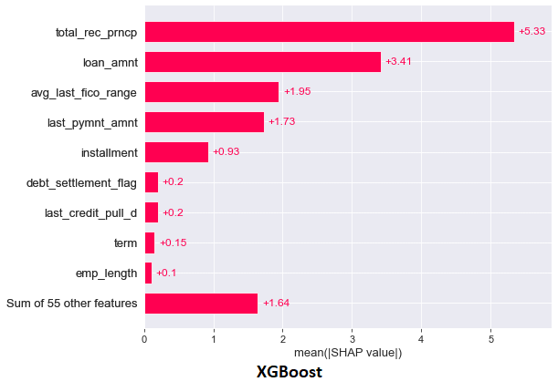
Result & Discussion

Slide 14
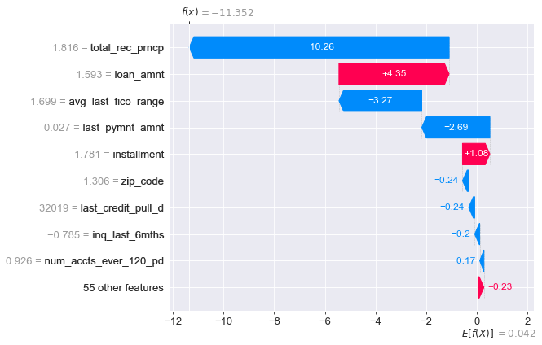
Result & Discussion

Slide 15
Conclusion
Major Achievements:
Achieved the lowest misclassification cost
Type-I error (misclassification of default as non-default) 0.279%.
Type-II error (misclassification of non-default as default) 0.005%.
Black-box nature of classifiers were interpreted by SHAP explainable AI.
Boosting classifier XGBoost with oversampling technique SMOTE achieved the highest evaluation score for cost-sensitive learning.
Other Achievement:
Performance of the stacking model of the three boosting classifiers with SMOTE achieved the same result as XGBoost-SMOTE.

Slide 16
Contribution & Future Scope
Contribution of the study
Combination of boosting classifier (XGBoost) with SMOTE provide the lowest misclassification error.
Using SHAP explainable AI make the cost-sensitive learning process transparent.
Future scope
Stacking model of boosting classifier and neural network with oversampling will be interesting to be explored.
Performance of boosting classifier with undersampling can be compare with the performance of this study.

Slide 17
Thank You

